Slide 1
4- Applications of GANs for Speech Generation
Risman Adnan Mattotorang
Software R&D Director
Samsung R&D Institute Indonesia

Slide 2
Welcome to Data Science Center UI
What You Will Learn Today
GANs Applications for Vision
GANs Applications for NLP
GANs Application for Speech
Reproduction of Some Models
What You Will Practice Today
Realistic Image Generation
Image to Image Translation
Password Cracking
Text to Speech

Slide 3
Outline
Speech Enhancement
Postfilter, speech synthesis, voice conversion
Speech Signal Recognition
Conclusion

Slide 4
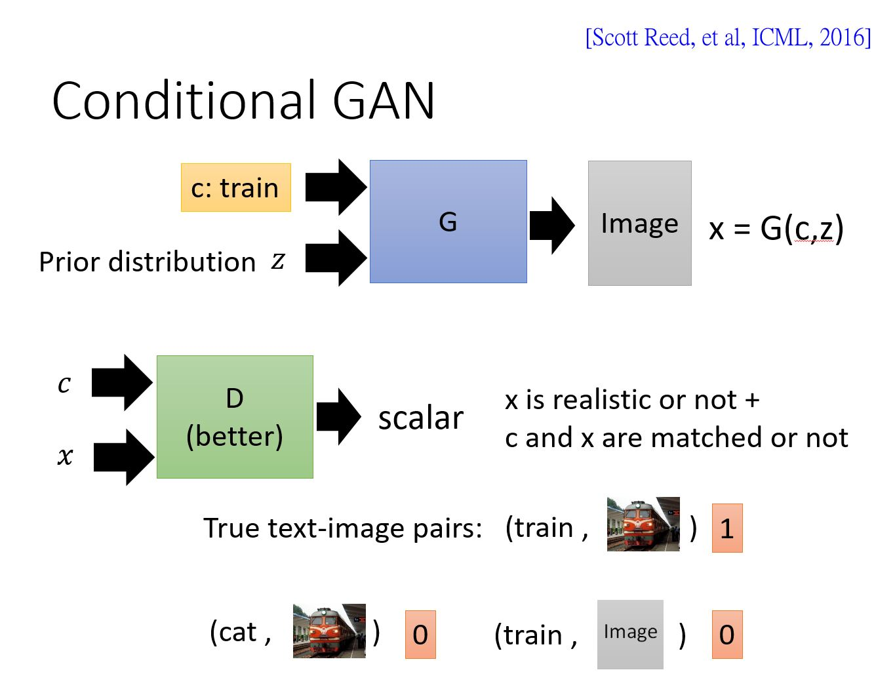
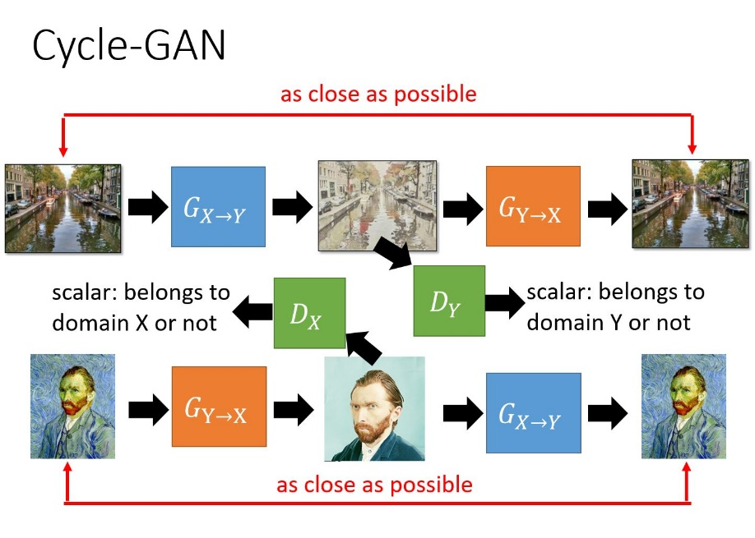
Speech Signal Generation
Paired
Regression Task:
GAN Models:
Objective function
G
Output

Slide 5
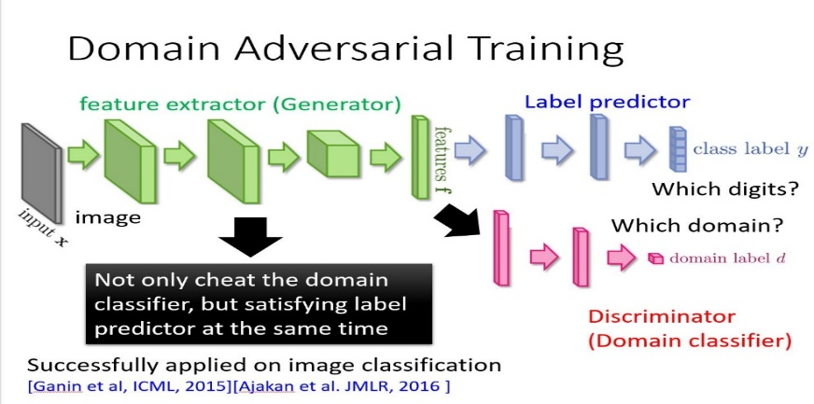
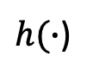
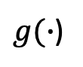
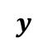
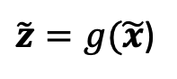

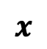

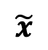
Speech, Speaker, Emotion Recognitions & Lip Reading Recognitions
Classification Task: GAN Model
$$y$$
Output
label
G
$h(∙$)
$\tilde{z}=g(\tilde{x}$)
Emb.
Acoustic Mismatch
E
$g(∙$)
$$\hat{x}$$
$$\breve{x}$$
$$\tilde{x}$$
Channel Distortion
Accented Speech
Noisy Data
$$x$$

Slide 6
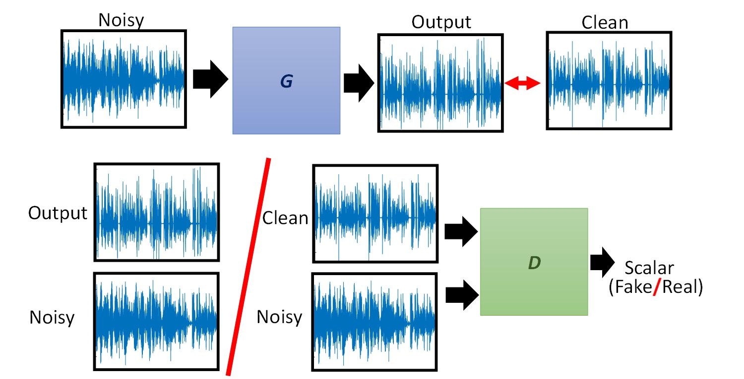
Speech Enhancement
Speech Enhancement using GAN [Pascual et al., Interspeech 2017]
z

Slide 7

Speech Enhancement
Enhancing
Neural network models for spectral mapping
Model structures of G: DNN [Wang et al. NIPS 2012; Xu et al., SPL 2014], DDAE [Lu et al., Interspeech 2013], RNN (LSTM) [Chen et al., Interspeech 2015; Weninger et al., LVA/ICA 2015], CNN [Fu et al., Interspeech 2016].
Typical objective function
Mean square error (MSE) [Xu et al., TASLP 2015], L1 [Pascual et al., Interspeech 2017], likelihood [Chai et al., MLSP 2017], STOI [Fu et al., TASLP 2018].
GAN is used as a new objective function to estimate the parameters in G.
Objective function
Output
G

Slide 8
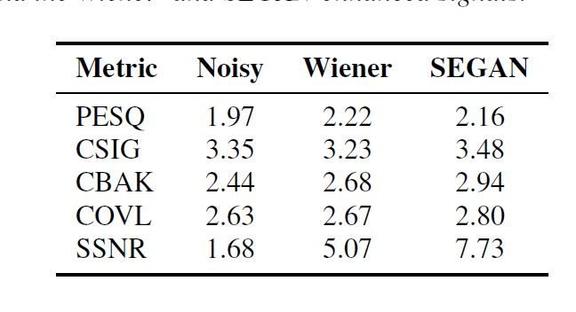
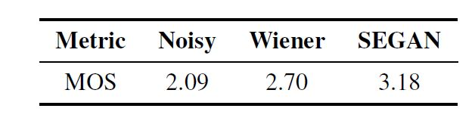
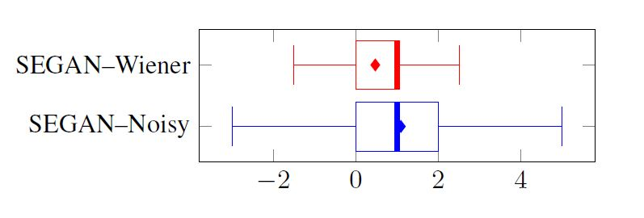
Speech Enhancement (SEGAN)
Experimental Result
Objective Evaluation Results
Subjective Evaluation Results
Preference Test Results
SEGAN yields better speech enhancement results than Noisy and Wiener.

Slide 9
Speech Enhancement
Pix2Pix [Michelsanti et al., Interpsech 2017]
Noisy
Output
Clean
G
Output
Clean
D
Scalar
(Fake/Real)
Noisy
Noisy

Slide 10
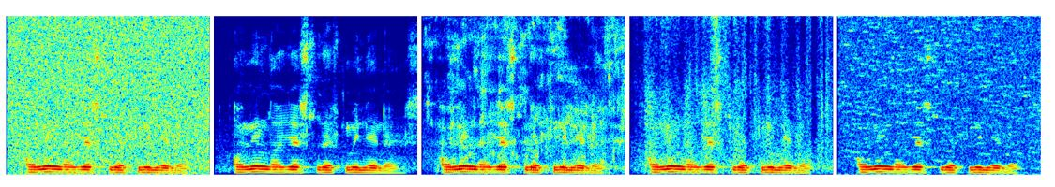
Speech Enhancement (Pix2Pix)
Spectrogram comparison of Pix2Pix with baseline methods.
Noisy
Clean
NG-Pix2Pix
NG-DNN
STAT-MMSE
Pix2Pix outperforms STAT-MMSE and is competitive to DNN SE.

Slide 11
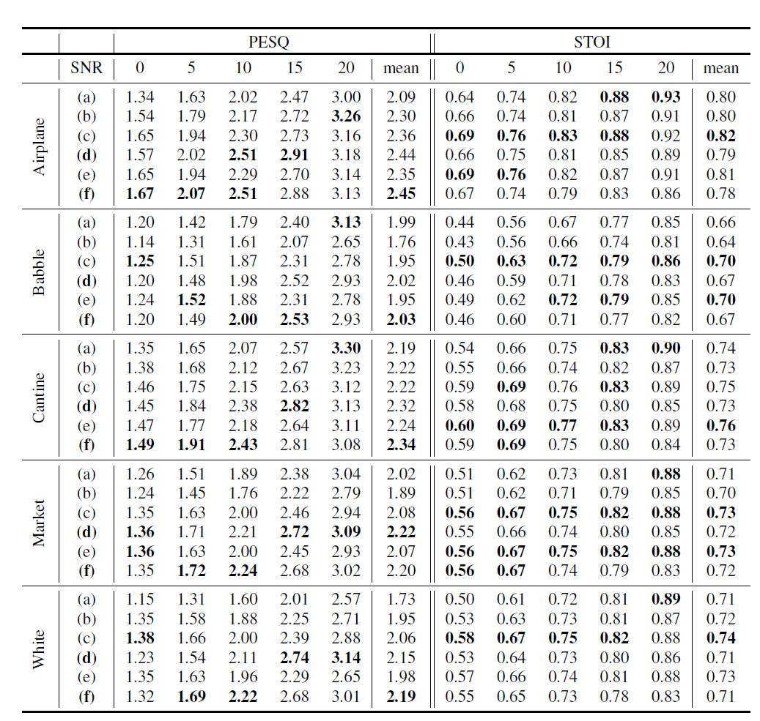
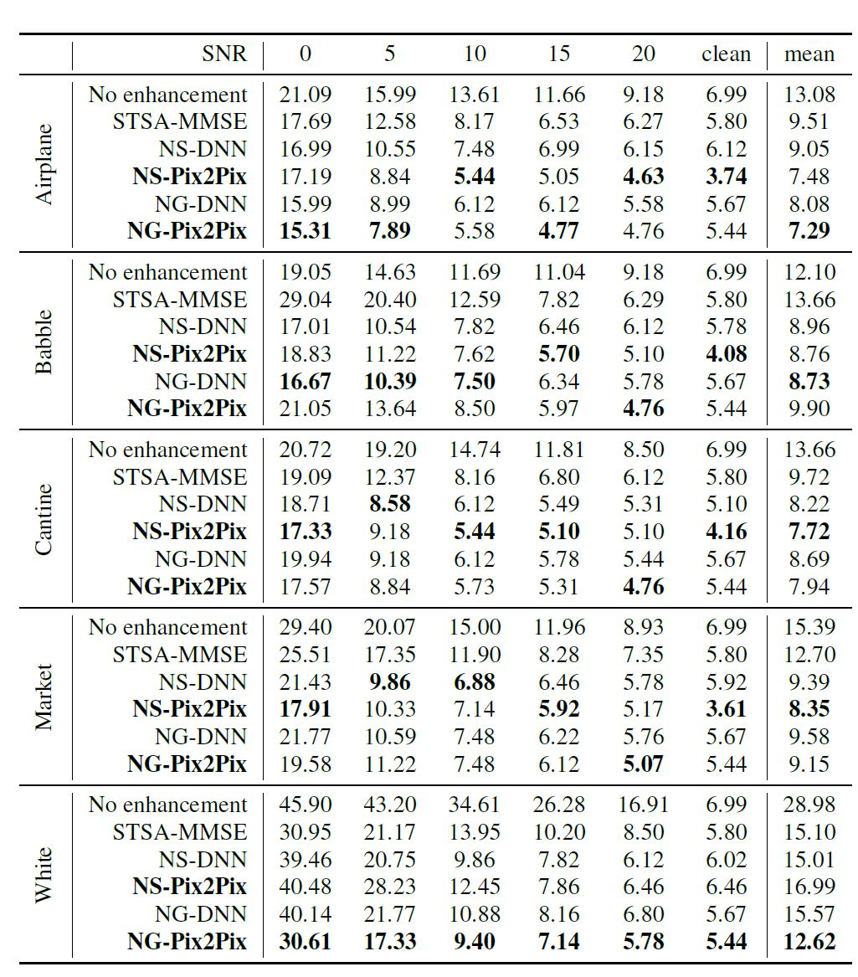
Speech Enhancement (Pix2Pix)
Objective evaluation and speaker verification test
From the PESQ and STOI evaluations, Pix2Pix outperforms Noisy and MMSE and is competitive to DNN SE.

Slide 12
Speech Enhancement
Frequency-domain SEGAN (FSEGAN) [Donahue et al., ICASSP 2018]
Noisy
Output
Clean
G
Output
Clean
D
Scalar
(Fake/Real)
Noisy
Noisy

Slide 13
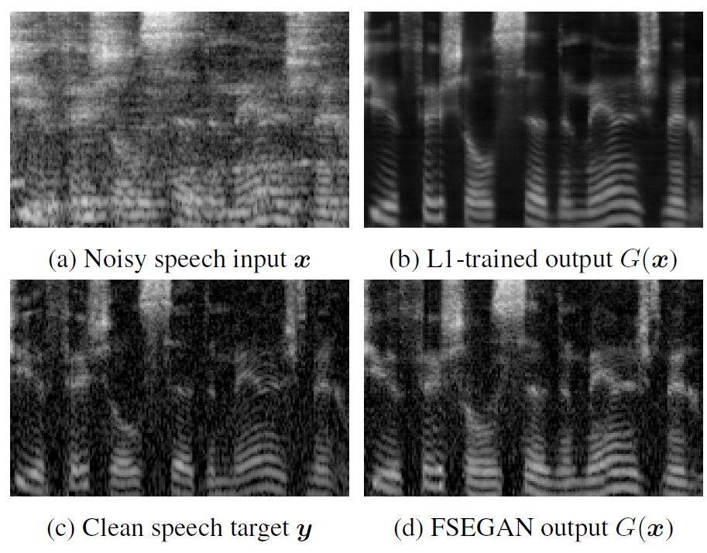
Speech Enhancement (FSEGAN)
Spectogram comparison of FSEGAN with L1-trained method.
FSEGAN ASR Results
FSEGAN reduces both additive noise and reverberant smearing.

Slide 14
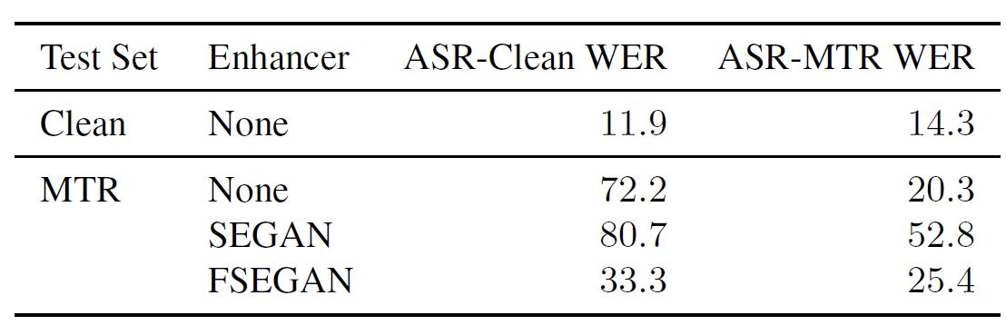
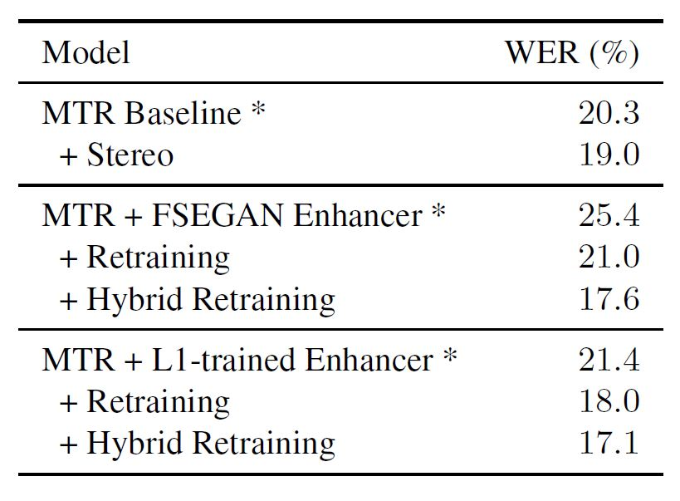
Speech Enhancement (FSEGAN)
FSEGAN ASR Results
WER (%) of SEGAN and FSEGAN.
WER (%) of FSEGAN with retrain.
FSEGAN improves recognition results for ASR-Clean.
FSEGAN outperforms SEGAN as front-ends.
Hybrid Retraining FSEGAN outperforms Baseline

Slide 15
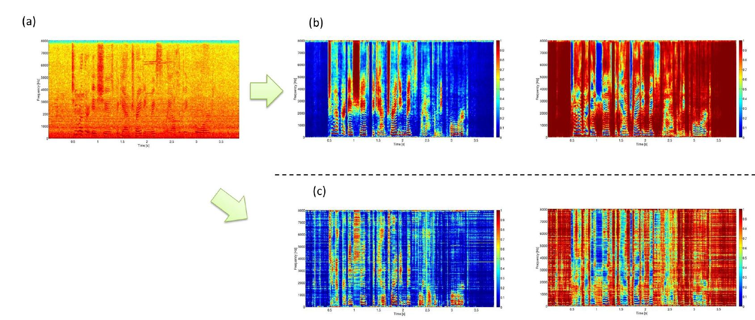
Speech Enhancement
Speech enhancement through a mask function
Noisy
Output mask
Enhanced
G
Point-wise multiplication

Slide 16
Speech Enhancement
GAN for spectral magnitude mask estimation (MMS-GAN) [Pandey, et.al, ICASSP 2018]
Noisy
Output mask
Ref. mask
G
z
Output
mask
Ref.
mask
D
Scalar
(Fake/Real)
Noisy
Noisy

Slide 17
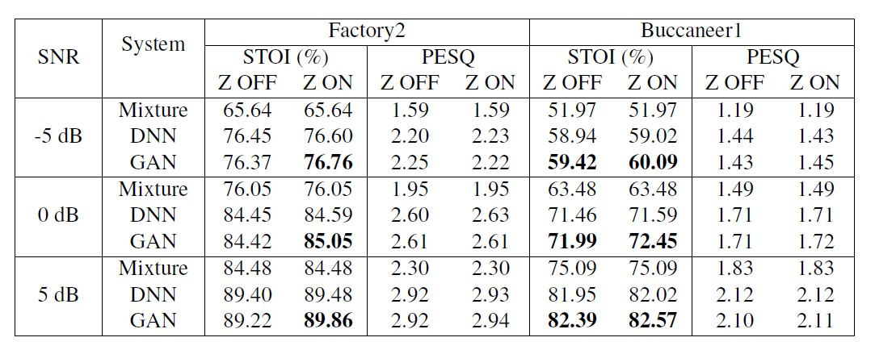
Speech Enhancement (MMS-GAN)
Speech enhancement results of MMS estimated by MSE (DNN) and by GAN (GAN) and for 2 unseen noises at 3 different SNR conditions.
GAN yields better performance with random noise, Z, than without Z.
GAN with Z outperforms DNN in terms of STOI scores, but no clear difference for PESQ scores

Slide 18
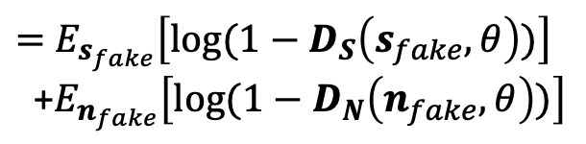
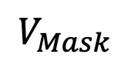

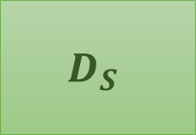
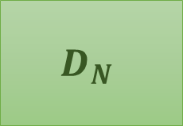
Speech Enhancement
Adversarial training based mask estimation (ATME) [Higuchi et al., ASRU 2017]
True or Fake
True or Fake
$$D_{S}$$
$$D_{N}$$
or
or
True noise
True speech
Estimated speech
Estimated noise
Noise data
Clean speech data
$$G_{Mask}$$
$$V_{Mask}$$
Noisy speech
$=$ $E_{s_{fake}}\left[log⁡(1−D_{S}\left(s_{fake},θ\right))\right]$
+$E_{n_{fake}}\left[log⁡(1−D_{N}\left(n_{fake},θ\right))\right]$
Noisy data

Slide 19
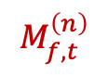
Speech Enhancement (ATME)
Spectrogram comparison of (a) noisy; (b) MMSE with supervision; (c) ATME without supervision.
Speech mask
Noise mask
$$M_{f,t}^{\left(n\right)}$$
The proposed adversarial training mask estimation can capture speech/noise signals without supervised data.

Slide 20
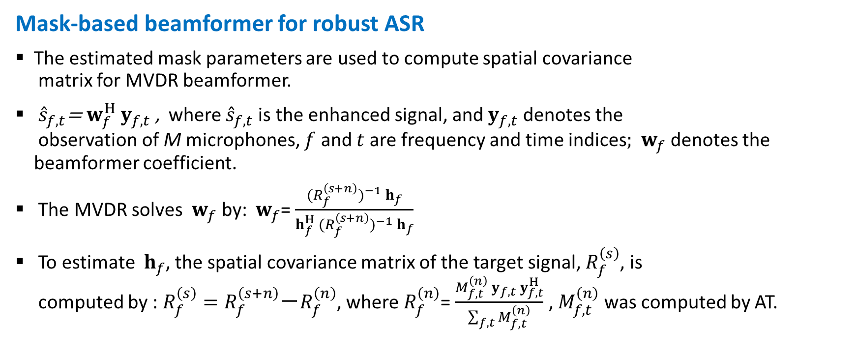
Speech Enhancement (ATME)
Mask-based beamformer for robust ASR
The estimated mask parameters are used to compute spatial covariance matrix for MVDR beamformer.
${\hat{s}}_{f,t}$= $w_{f}^{H}{ y}_{f,t}$ , where ${\hat{s}}_{f,t}$ is the enhanced signal, and${ y}_{f,t}$ denotes the observation of M microphones, $f$ and $t$ are frequency and time indices; ${ w}_{f}$ denotes the beamformer coefficient.
The MVDR solves ${ w}_{f}$ by: ${ w}_{f}$= $\frac{{{(R_{f}^{\left(s+n\right)})}^{−1} h}_{f}}{h_{f}^{H} {(R_{f}^{\left(s+n\right)})}^{−1}{ h}_{f}}$
To estimate ${ h}_{f}$, the spatial covariance matrix of the target signal, $R_{f}^{\left(s\right)}$, is computed by : $R_{f}^{\left(s\right)}=R_{f}^{\left(s+n\right)}$－$R_{f}^{\left(n\right)}$, where $R_{f}^{\left(n\right)}$= $\frac{{M_{f,t}^{\left(n\right)} y}_{f,t} y_{f,t}^{H}}{\sum_{f,t}{M_{f,t}^{\left(n\right)}}}$ , $M_{f,t}^{\left(n\right)}$ was computed by AT.

Slide 21
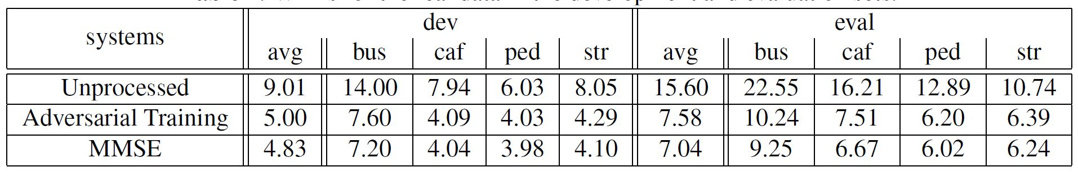
Speech Enhancement (ATME)
WERs (%) for the development and evaluation sets.
1. ATME provides significant improvements over Unprocessed.
2. Unsupervised ATME slightly underperforms supervised MMSE.

Slide 22
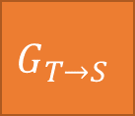
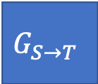


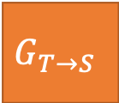
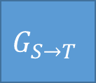
Speech Enhancement (AFT)
Cycle-GAN-based acoustic feature transformation (AFT) [Mimura et al., ASRU 2017]
as close as possible
Clean
Syn. Noisy
Clean
$$G_{S→T}$$
$$G_{T→S}$$
Scalar: belongs to domain S or not
$$D_{S}$$
$$D_{T}$$
Scalar: belongs to domain T or not
$$G_{T→S}$$
$$G_{S→T}$$
Noisy
Enhanced
Noisy
as close as possible
$V_{Full}$ = $V_{GAN}\left(G_{X→Y},D_{Y}\right)＋V_{GAN}\left(G_{X→Y},D_{Y}\right) ＋λ{ V}_{Cyc}(G_{X→Y},G_{Y→X})$

Slide 23
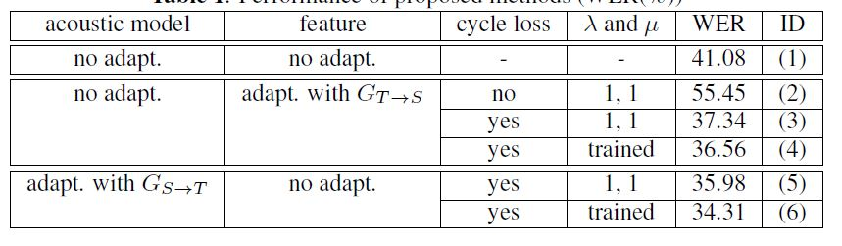
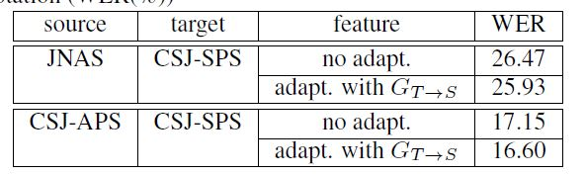
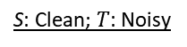
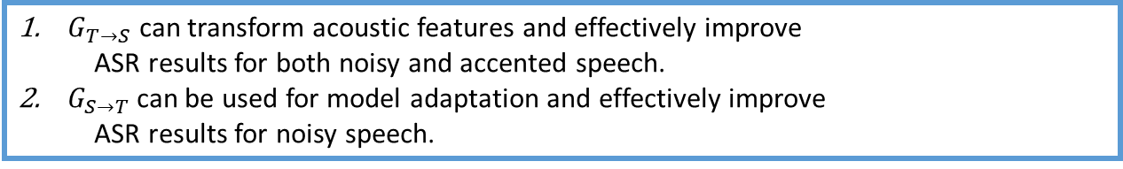
Speech Enhancement (AFT)
ASR results on noise robustness and style adaptation
Noise robust ASR
Speaker style adaptation.
S: Clean; $T$: Noisy
JNAS: Read; CSJ-SPS: Spontaneous (relax);
CSJ-APS: Spontaneous (formal);
$G_{T→S}$ can transform acoustic features and effectively improve ASR results for both noisy and accented speech.
$G_{S→T}$ can be used for model adaptation and effectively improve ASR results for noisy speech.

Slide 24
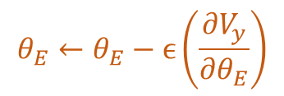

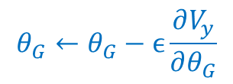

Speech Enhancement
Noise Adaptive Speech Enhancement (NA-SE) [Chien-Feng Liao, Yu Tsao, Hung-Yi Lee, Hsin-Min Wang., arXiv 2018]
N11
N12
N5
N4
N5
N7
N10
N9
Unseen
$$V_{y}$$
E
G
$$z$$
$$θ_{G}←θ_{G}−ϵ\frac{∂V_{y}}{∂θ_{G}}$$
Min reconstruction
error
$$θ_{E}←θ_{E}−ϵ\left(\frac{∂V_{y}}{∂θ_{E}}\right)$$
Min reconstruction error

Slide 25
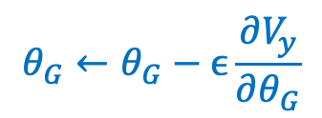
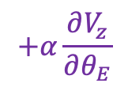
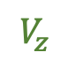
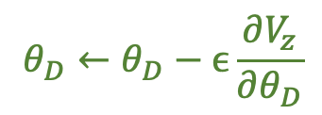
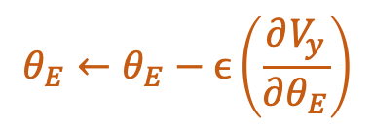
Speech Enhancement (NA-SE)
Domain adversarial training for NA-SE
N11
N12
N5
N4
N5
N7
N10
N9
Unseen
$$V_{y}$$
E
G
D
$$z$$
Output 2 Speaker
$$θ_{G}←θ_{G}−ϵ\frac{∂V_{y}}{∂θ_{G}}$$
$$V_{z}$$
Min reconstruction
error
$$θ_{E}←θ_{E}−ϵ\left(\frac{∂V_{y}}{∂θ_{E}}\right)$$
$$+α\frac{∂V_{z}}{∂θ_{E}}$$
$$θ_{D}←θ_{D}−ϵ\frac{∂V_{z}}{∂θ_{D}}$$
Max domain accuracy
Min reconstruction error
and Min domain accuracy

Slide 26
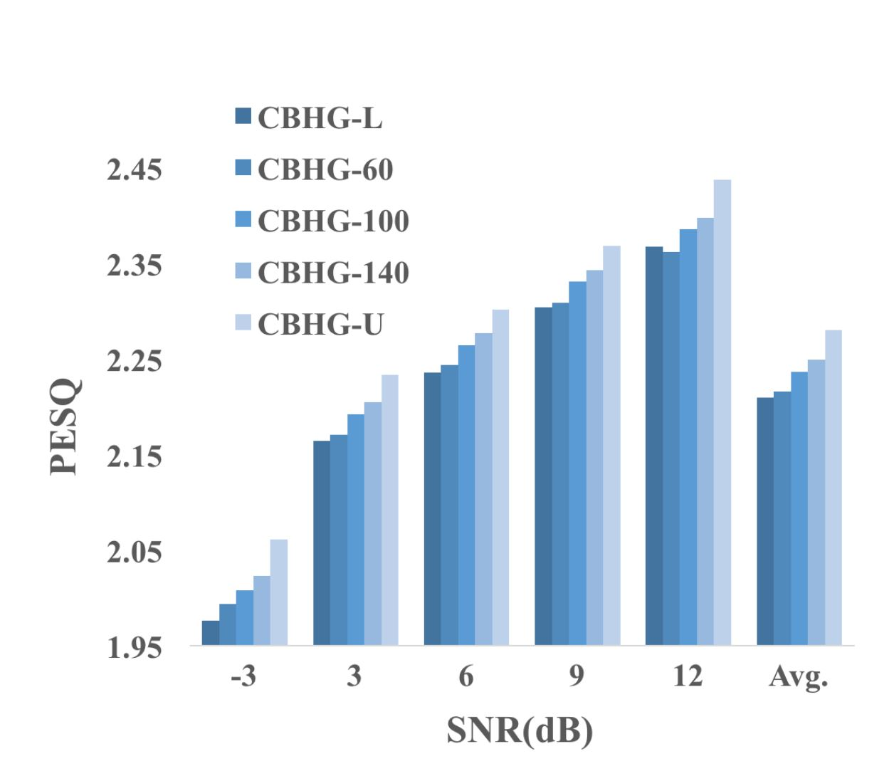
Speech Enhancement (NA-SE)
Objective evaluations
PESQ at different SNR levels.
The DAT-based unsupervised adaptation can notably overcome the mismatch issue of training and testing noise types.

Slide 27
Outline
Speech Enhancement
Postfilter, speech synthesis, voice conversion
Speech Signal Recognition
Conclusion

Slide 28
Postfilter
Postfilter for synthesized or transformed speech
Natural spectral texture
Speech synthesizer
Synthesized spectral texture
Objective function
Voice
conversion
G
Output
Speech
enhancement
Conventional postfilter approaches for G estimation include global variance (GV) [Toda et al., IEICE 2007], variance scaling (VS) [Sil’en et al., Interpseech 2012], modulation spectrum (MS) [Takamichi et al., ICASSP 2014],DNN with MSE criterion [Chen et al., Interspeech 2014; Chen et al., TASLP 2015].
GAN is used a new objective function to estimate the parameters in G.

Slide 29
Postfilter
GAN postfilter [Kaneko et al., ICASSP 2017]
Natural Mel cepst. coef.
Synthesized
Mel cepst. coef.
Generated
Mel cepst. coef.
Nature
or
Generated
G
D
Traditional MMSE criterion results in statistical averaging.
GAN is used as a new objective function to estimate the parameters in G.
The proposed work intends to further improve the naturalness of synthesized speech or parameters from a synthesizer.

Slide 30
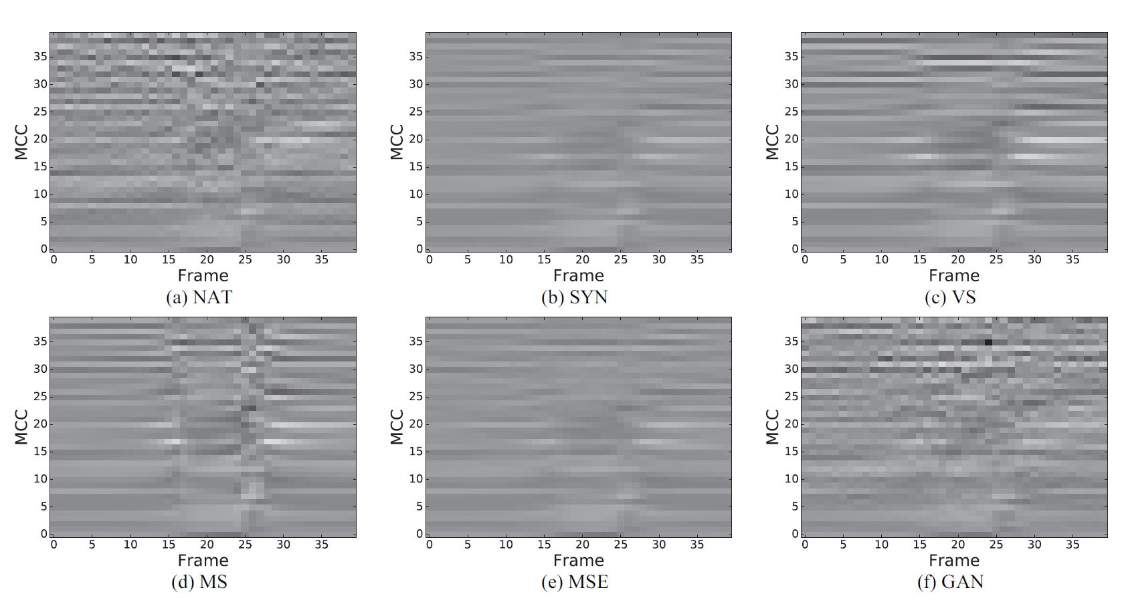
Postfilter (GAN-based Postfilter)
Spectrograms of: (a) NAT (nature); (b) SYN (synthesized); (c) VS (variance scaling); (d) MS (modulation spectrum); (e) MSE; (f) GAN postfilters.
GAN postfilter reconstructs spectral texture similar to the natural one.

Slide 31
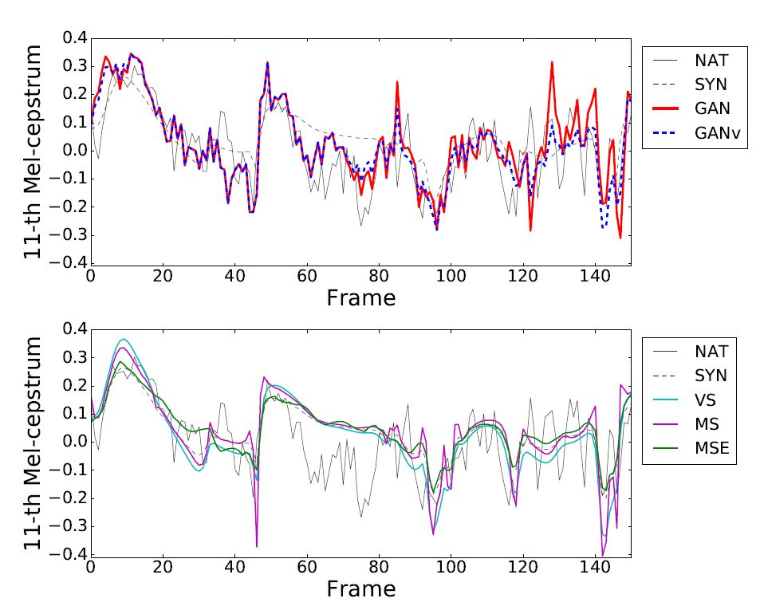
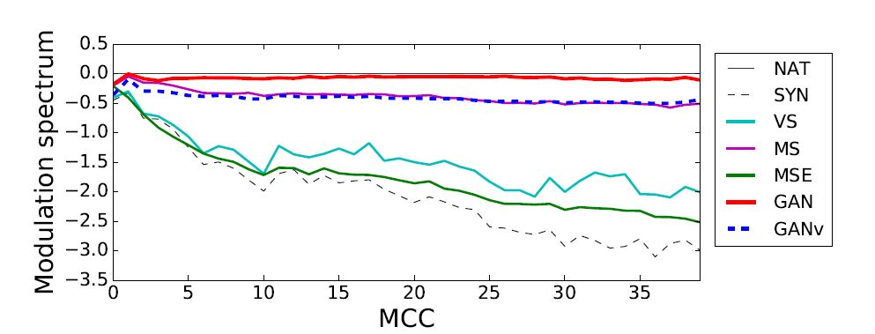
Postfilter (GAN-based Postfilter)
Objective evaluations
Mel-cepstral trajectories (GANv: GAN was applied in voiced part).
Averaging difference in modulation spectrum per Mel-cepstral coefficient.
GAN postfilter reconstructs spectral texture similar to the natural one.

Slide 32
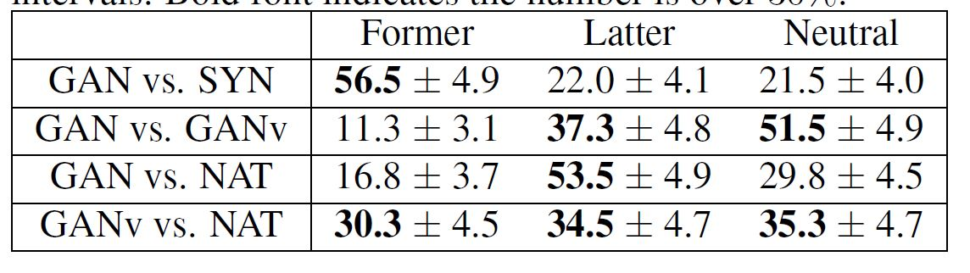
Postfilter (GAN-based Postfilter)
Subjective evaluations
Preference score (%). Bold font indicates the numbers over 30%.
GAN postfilter significantly improves the synthesized speech.
GAN postfilter is effective particularly in voiced segments.
GANv outperforms GAN and is comparable to NAT.

Slide 33
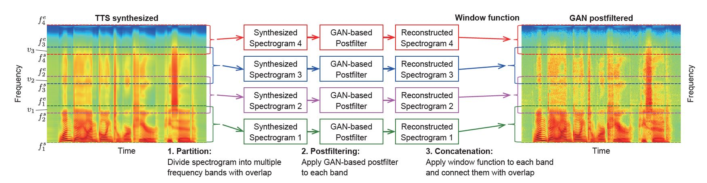
Postfilter (GAN-postfilter-SFTF)
GAN post-filter for STFT spectrograms [Kaneko et al., Interspeech 2017]
GAN postfilter was applied on high-dimensional STFT spectrograms.
The spectrogram was partitioned into N bands (each band overlaps its neighboring bands).
The GAN-based postfilter was trained for each band.
The reconstructed spectrogram from each band was smoothly connected.

Slide 34
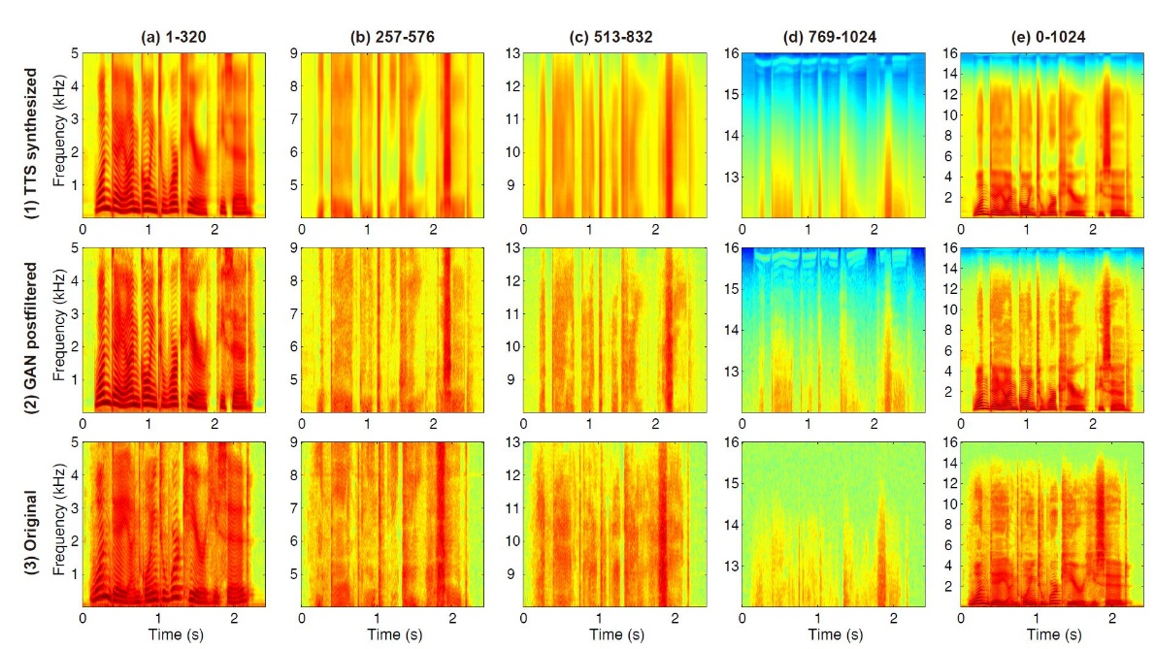
Postfilter (GAN-postfilter-SFTF)
Spectrograms of: (1) SYN, (2) GAN, (3) Original (NAT)
GAN postfilter reconstructs spectral texture similar to the natural one.

Slide 35


Speech Synthesis
Speech synthesis with anti-spoofing verification (ASV) [Saito et al., ICASSP 2017]
Input: linguistic features; Output: speech parameters

Slide 36


Speech Synthesis (ASV)
Objective and subjective evaluations
Averaged GVs of MCCs.
Scores of speech quality.
The proposed algorithm generates MCCs similar to the natural ones.
The proposed algorithm outperforms conventional MGE training.

Slide 37

Speech Synthesis
Speech synthesis with GAN (SS-GAN) [Saito et al., TASLP 2018]

Slide 38


Speech Synthesis (SS-GAN)
Subjective Evaluation
Scores of speech quality (sp).
Scores of speech quality (sp and F0).
The proposed algorithm works for both spectral parameters and F0.
.

Slide 39

Speech Synthesis
Speech synthesis with GAN glottal waveform model (GlottGAN) [Bollepalli et al., Interspeech 2017]
Glottal waveform
Glottal waveform
G
Generated speech
parameters
Natural speech
parameters
Acoustic
features
$$D$$
Gen.
Nature

Slide 40

Speech Synthesis (GlottGAN)
Objective Evaluation
Glottal pulses generated by GANs.
G, D: DNN
G, D: conditional DNN
G, D: Deep CNN
G, D: Deep CNN + LS loss
The proposed GAN-based approach can generate glottal waveforms similar to the natural ones.

Slide 41

Speech Synthesis
Speech synthesis with GAN & multi-task learning (SS-GAN-MTL) [Yang et al., ASRU 2017]

Slide 42

Speech Synthesis (SS-GAN-MTL)
Speech synthesis with GAN & multi-task learning (SS-GAN-MTL) [Yang et al., ASRU 2017]

Slide 43


Speech Synthesis (SS-GAN-MTL)
Objective and subjective evaluations
Objective evaluation results.
The preference score (%).
From objective evaluations, no remarkable difference is observed.
From subjective evaluations, GAN outperforms BLSTM and ASV, while GAN-PC underperforms GAN.

Slide 44


Voice Conversion
Convert (transform) speech from source to target
Target speaker
Source speaker
Objective function
G
Output
Conventional VC approaches include Gaussian mixture model (GMM) [Toda et al., TASLP 2007], non-negative matrix factorization (NMF) [Wu et al., TASLP 2014; Fu et al., TBME 2017], locally linear embedding (LLE) [Wu et al., Interspeech 2016], restricted Boltzmann machine (RBM) [Chen et al., TASLP 2014], feed forward NN [Desai et al., TASLP 2010], recurrent NN (RNN) [Nakashika et al., Interspeech 2014].

Slide 45



Voice Conversion
Target speaker
VAW-GAN [Hsu et al., Interspeech 2017]
Source speaker
Real
or
Fake
G
D
Conventional MMSE approaches often encounter the “over-smoothing” issue.
GAN is used a new objective function to estimate G.
The goal is to increase the naturalness, clarity, similarity of converted speech.
$$V\left(G,D\right)=V_{GAN}\left(G,D\right)+λV_{VAE}\left(x|y\right)$$

Slide 46


Voice Conversion (VAW-GAN)
Objective and subjective evaluations
The spectral envelopes.
MOS on naturalness.
VAW-GAN outperforms VAE in terms of objective and subjective evaluations with generating more structured speech.

Slide 47





Voice Conversion
Sequence-to-sequence VC with learned similarity metric (LSM) [Kaneko et al., Interspeech 2017]
Target speaker
$$y$$
Source speaker
$$C$$
Real
or
Fake
D
$$z$$
$$G$$
Noise
Similarity metric
$V_{SVC}^{D_{l}}\left(C,D\right)$=$\frac{1}{M_{l}}{\left\|D_{l}\left(y\right)−D_{l}\left(C(x\right))\right\|}^{2}$
$$V\left(C, G,D\right)=V_{SVC}^{D_{l}}\left(C,D\right)+V_{GAN}(C,G,D)$$

Slide 48

Voice Conversion (LSM)
Spectrogram Analysis
Comparison of MCCs (upper) and STFT spectrograms (lower).
Source
Target
FVC
MSE(S2S)
LSM(S2S)
The spectral textures of LSM are more similar to the target ones.

Slide 49



Voice Conversion (LSM)
Subjective evaluations
Preference scores for naturalness.
Similarity of TGT and SRC with VCs.
Table 14: Preference scores for clarity.
Target speaker
Source speaker
LSM outperforms FVC and MSE in terms of subjective evaluations.

Slide 50







Voice Conversion (CycleGAN-VC)
CycleGAN-VC [Kaneko et al., arXiv 2017]
as close as possible
Source
Syn. Target
Source
$$G_{S→T}$$
$$G_{T→S}$$
Scalar: belongs to domain S or not
$$D_{S}$$
$$D_{T}$$
Scalar: belongs to domain T or not
$$G_{T→S}$$
$$G_{S→T}$$
Target
Syn. Source
Target
as close as possible
$V_{Full}$ = $V_{GAN}\left(G_{X→Y},D_{Y}\right)＋V_{GAN}\left(G_{X→Y},D_{Y}\right)$ $＋λ{ V}_{Cyc}(G_{X→Y},G_{Y→X})$

Slide 51


Voice Conversion
Subjective evaluations
Similarity of to source and to target speakers. S: Source; T:Target; P: Proposed; B:Baseline
MOS for naturalness.
Target speaker
Source speaker
The proposed method uses non-parallel data.
For naturalness, the proposed method outperforms baseline.
For similarity, the proposed method is comparable to the baseline.

Slide 52














Voice Conversion
Multi-target VC [Chou et al., Interspeech 2018]
Stage-1
C
$$y$$
$E$nc
Dec
···
$$enc(x)$$
$$x$$
$$dec(enc\left(x\right),y)$$
$$dec(enc\left(x\right),y′)$$
Stage-2
$$y$$
$y′$····
$$y"$$
$E$nc
Dec
$$enc(x)$$
F/R
$$x$$
D+C
$$G$$
ID
Real
data
$$y"$$

Slide 53


Voice Conversion
Controller-generator-discriminator VC on Impaired Speech [Li-Wei Chen, Yu Tsao, Hung-Yi Lee, arXiv 2018]
Previous applications: hearing aids; murmur to normal speech; bone-conductive microphone to air-conductive microphone.
Proposed: improving the speech intelligibility of surgical patients.
Target: oral cancer (top five cancer for male in Taiwan).
Before
After
Before
After

Slide 54

Voice Conversion
Controller-generator-discriminator VC (CGD VC) on impaired speech [Li-Wei Chen, Yu Tsao, Hung-Yi Lee, arXiv 2018]

Slide 55


Voice Conversion (CGD VC)
Detailed architectures of C, G, and D
G and D are trained using standard conditional GAN procedure.
An additional loss is designed for training C: $L_{c}=𝔼_{x^{s}\sim S}[L\left(G\left(C\left(x^{s}\right)\right),x^{s})\right]$.
Instead of low-level details, we want to measure high-level difference.
The perceptual loss is used : $L\left(x,x^{′}\right)=\sum_{l}{2^{−2l}{|D_{l}\left(x\right)−D_{l}(x′)|}_{1}}$, where $l$ denotes the $l$-th hidden layer output.

Slide 56

Voice Conversion (CGD VC)
Spectrogram analysis
Spectrogram comparison of CGD with CycleGAN.

Slide 57

Voice Conversion (CGD VC)
Subjective evaluations
MOS for content similarity, speaker similarity, and articulation.
The proposed method outperforms conditional GAN and CycleGAN in terms of content similarity, speaker similarity, and articulation.

Slide 58
Outline
Speech Enhancement
Postfilter, speech synthesis, voice conversion
Speech Signal Recognition
Conclusion

Slide 59
Speech, Speaker, Emotion Recognitions & Lip Reading Recognitions
Classification Task: GAN Model:
$$y$$
Output
label
G
$h(∙$)
$\tilde{z}=g(\tilde{x}$)
Emb.
Acoustic Mismatch
E
$g(∙$)
$$\hat{x}$$
$$\breve{x}$$
$$\tilde{x}$$
Channel Distortion
Accented Speech
Noisy Data
$$x$$

Slide 60











Speech Recognition
Adversarial multi-task learning (AMT) [Shinohara Interspeech 2016]
$$y$$
$$z$$
Objective function
Output 1 Senone
Output 2 Domain
$V_{y}$=$−\sum_{i}{log⁡P(y_{i}|x_{i};θ_{E},θ_{G})}$
$V_{z}$=$−\sum_{i}{log⁡P(z_{i}|x_{i};θ_{E},θ_{D})}$
G
D
Model update
$$V_{y}$$
$$V_{z}$$
$$θ_{G}←θ_{G}−ϵ\frac{∂V_{y}}{∂θ_{G}}$$
Max classification accuracy
GRL
E
$$θ_{D}←θ_{D}−ϵ\frac{∂V_{z}}{∂θ_{D}}$$
Max domain accuracy
$$θ_{E}←θ_{E}−ϵ\left(\frac{∂V_{y}}{∂θ_{E}}\right)$$
$$+α\frac{∂V_{z}}{∂θ_{E}}$$
$$x$$
Input
Acoustic feature
Max classification accuracy
and Min domain accuracy

Slide 61

Speech Recognition (AMT)
ASR results in known (k) and unknown (unk) noisy conditions
WER of DNNs with single-task learning (ST) and AMT.
The AMT-DNN outperforms ST-DNN with yielding lower WERs.

Slide 62





Speech Recognition
Domain adversarial training for accented ASR (DAT) [Sun et al., ICASSP2018]
$$y$$
$$z$$
Objective function
Output 1 Senone
Output 2 Domain
$V_{y}$=$−\sum_{i}{log⁡P(y_{i}|x_{i};θ_{E},θ_{G})}$
$V_{z}$=$−\sum_{i}{log⁡P(z_{i}|x_{i};θ_{E},θ_{D})}$
G
D
$$V_{y}$$
$$V_{z}$$
Model update
$$θ_{G}←θ_{G}−ϵ\frac{∂V_{y}}{∂θ_{G}}$$
Max classification accuracy
GRL
E
$$θ_{D}←θ_{D}−ϵ\frac{∂V_{z}}{∂θ_{D}}$$
Max domain accuracy
$$θ_{E}←θ_{E}−ϵ\left(\frac{∂V_{y}}{∂θ_{E}}\right)$$
$$+α\frac{∂V_{z}}{∂θ_{E}}$$
$$x$$
Input
Acoustic feature
Max classification accuracy
and Min domain accuracy

Slide 63

Speech Recognition (DAT)
ASR results on accented speech
WER of the baseline and adapted model.
STD: standard speech
With labeled transcriptions, ASR performance notably improves.
DAT is effective in learning features invariant to domain differences with and without labeled transcriptions.

Slide 64









Speech Recognition
Robust ASR using GAN enhancer (GAN-Enhancer) [Sriram et al., arXiv 2017]
$$y$$
Output 1 Senone
Cross entropy with L1 Enhancer:
L1
$$H\left(h\left(\tilde{z}\right),y\right)+λ\frac{{\left\|z−\tilde{z}\right\|}_{1}}{{\left\|z\right\|}_{1}+{\left\|\tilde{z}\right\|}_{1}+ε}$$
D
G
$h(∙$)
$z=g(x$)
$\tilde{z}=g(\tilde{x}$)
Emb.
Emb.
$g(∙$)
E
E
Cross entropy with GAN Enhancer:
$g(∙$)
$H\left(h\left(\tilde{z}\right),y\right)+λ{ V}_{adv}$($g(x$) , $g(\tilde{x}$))
$$x$$
$$\tilde{x}$$
Noisy data
Clean data

Slide 65

Speech Recognition (GAN-Enhancer)
ASR results on far-field speech:
WER of GAN enhancer and the baseline methods.
GAN Enhancer outperforms the Augmentation and L1-Enhancer approaches on far-field speech.

Slide 66





Speaker Recognition
Domain adversarial neural network (DANN) [Wang et al., ICASSP 2018]
$$y$$
$$z$$
Output 1 Speaker ID
Output 2 Domain
G
D
$$V_{y}$$
$$V_{z}$$
Enroll i-vector
GRL
DANN
Pre-processing
E
Scoring
DANN
Pre-processing
Test i-vector
$$x$$
Input
Acoustic feature

Slide 67

Speaker Recognition (DANN)
Recognition results of domain mismatched conditions
Performance of DAT and the state-of-the-art methods.
The DAT approach outperforms other methods with achieving lowest EER and DCF scores.

Slide 68









Emotion Recognition
Adversarial AE for emotion recognition (AAE-ER) [Sahu et al., Interspeech 2017]
$$x$$
AE with GAN :
$H\left(h\left(z\right),x\right)+λ{ V}_{GAN}$($q$, $g(x$))
D
G
$h(∙$)
$$q$$
Emb.
$z=g(x$)
Syn.
E
$g(∙$)
$$x$$
The distribution of code vectors

Slide 69



Emotion Recognition (AAE-ER)
Recognition results of domain mismatched conditions:
Classification results on different systems.
Classification results on real and synthesized features.
Original
Training data
AAE alone could not yield performance improvements.
Using synthetic data from AAE can yield higher UAR.

Slide 70










Lip-reading
Domain adversarial training for lip-reading (DAT-LR) [Wand et al., arXiv 2017]
$$y$$
Objective function
$$z$$
Output 1 Words
Output 2 Speaker
$V_{y}$=$−\sum_{i}{log⁡P(y_{i}|x_{i};θ_{E},θ_{G})}$
$V_{z}$=$−\sum_{i}{log⁡P(z_{i}|x_{i};θ_{E},θ_{D})}$
G
D
Model update
$$V_{y}$$
$$V_{z}$$
$$θ_{G}←θ_{G}−ϵ\frac{∂V_{y}}{∂θ_{G}}$$
Max classification accuracy
GRL
$$θ_{D}←θ_{D}−ϵ\frac{∂V_{z}}{∂θ_{D}}$$
Max domain accuracy
E
$$θ_{E}←θ_{E}−ϵ\left(\frac{∂V_{y}}{∂θ_{E}}\right)$$
$$+α\frac{∂V_{z}}{∂θ_{E}}$$
Max classification accuracy
$$x$$
and Min domain accuracy
~80% WAC

Slide 71

Lip-reading (DAT-LR)
Recognition results of speaker mismatched conditions
Performance of DAT and the baseline.
The DAT approach notably enhances the recognition accuracies in different conditions.

Slide 72
Outline
Speech Enhancement
Postfilter, speech synthesis, voice conversion
Speech Signal Recognition
Conclusion

Slide 73
Speech Signal Generation
Paired
Regression Task:
GAN Models:
Objective function
G
Output

Slide 74
Speech, Speaker, Emotion Recognitions & Lip Reading Recognitions
Classification Task: GAN Model
$$y$$
Output
label
G
$h(∙$)
$\tilde{z}=g(\tilde{x}$)
Emb.
Acoustic Mismatch
E
$g(∙$)
$$\hat{x}$$
$$\breve{x}$$
$$\tilde{x}$$
Channel Distortion
Accented Speech
Noisy Data
$$x$$

Slide 75
More GANs in Speech
Diagnosis of Autism Spectrum
Deng, et.al., Speech-based Diagnosis of Autism Spectrum Condition by Generative Adversarial Network Representations, ACM DH, 2017.
Emotion Recognition
Chang, et.al., Learning Representations of Emotional Speech with Deep Convolutional Generative Adversarial Networks, ICASSP, 2017.
Robust ASR
Serdyuk, et.al., Invariant Representations for Noisy Speech Recognition, arXiv, 2016.
Speaker Verification
Hong Yu, Zheng-Hua Tan, Zhanyu Ma, and Jun Guo, Adversarial Network Bottleneck Features for Noise Robust Speaker Verification, arXiv, 2017.

Slide 76
Welcome to Data Science Center UI
What You Will Learn Today
GANs Applications for Vision
GANs Applications for NLP
GANs Application for Speech
Reproduction of Some Models
What You Will Practice Today
Realistic Image Generation
Image to Image Translation
Password Cracking
Text to Speech

